Slide 1
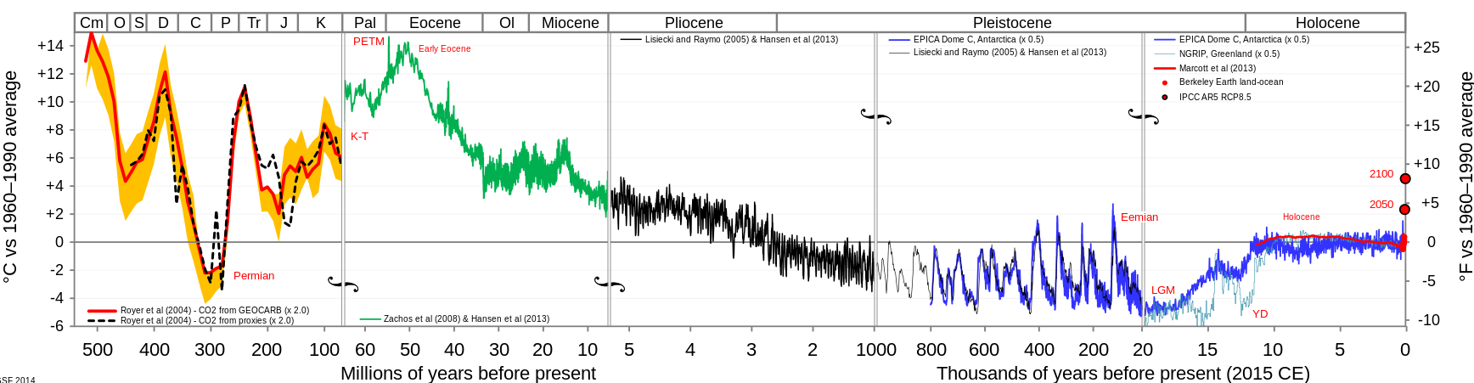
Climate synchronicity in the Pleistocene => power steering (positive feedbacks)
Past Present
Hothouse Earth
Icehouse Earth
Glacial-interglacial cycling

Slide 2
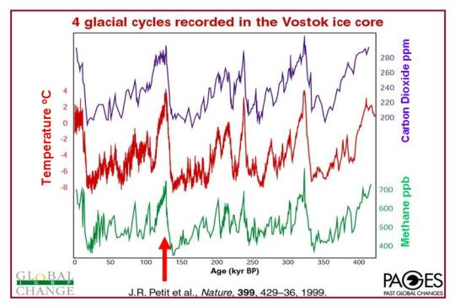
Climate synchronicity in the Pleistocene => power steering (positive feedbacks)
Present Past
The fact that temperature, CO₂, and CH₄ are in very tight correlation suggests a positive feedback loop, like power steering in an automobile.
Over the last few million years, Milankovich wobbling is driving.
Now, human emissions are driving.
There are other lessons as we look back further in time.

Slide 3
55 million years ago, Hothouse Earth
Past Present
Hothouse Earth
Icehouse Earth

Slide 4
Then, collision of India with Asia
Past Present
Hothouse Earth
Icehouse Earth
Collision video

Slide 5
Basically, “Icehouse Earth” involves the creation of lots of ice on Earth’s surface (cryosphere)
Permanent ice in Greenland forms
Arctic ice persists throughout the summer
Hothouse Earth
Icehouse Earth
Permanent ice forms in the East Antarctic
Northern Hemisphere ice sheets form and disappear. The last disappeared 20,000 years ago (so we don’t have to worry about them)
The West Antarctic Ice Sheet (WAIS) forms and disappears. The last time was during the Eemian (and the Anthropocene is even warmer).

Slide 6
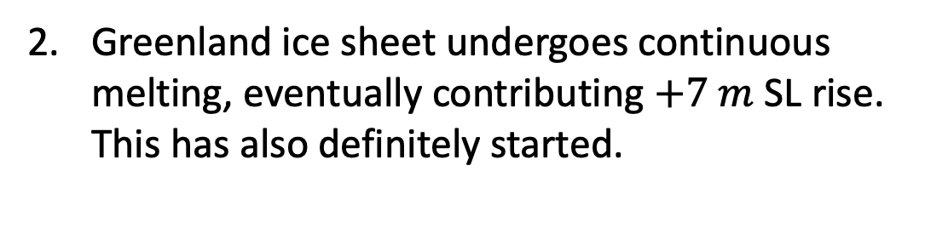
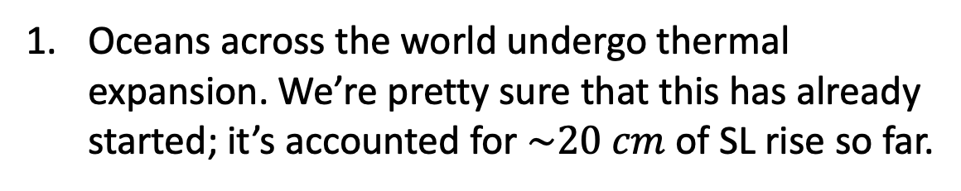
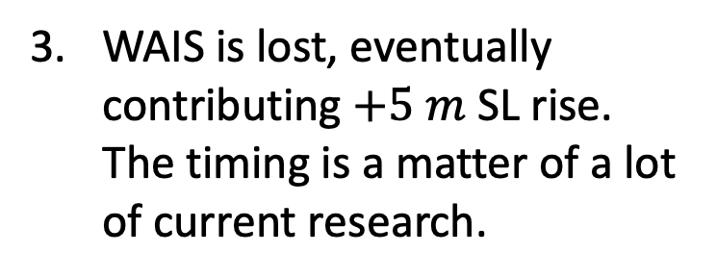
Therefore we can predict the likely sequence of (human-driven) steps back to Hothouse Earth
Greenland ice sheet undergoes continuous melting, eventually contributing $+7 m$ SL rise. This has also definitely started.
time
Hothouse Earth
Icehouse Earth
WAIS is lost, eventually contributing $+5 m$ SL rise. The timing is a matter of a lot of current research.
Oceans across the world undergo thermal expansion. We’re pretty sure that this has already started; it’s accounted for $\sim 20 cm$ of SL rise so far.

Slide 7
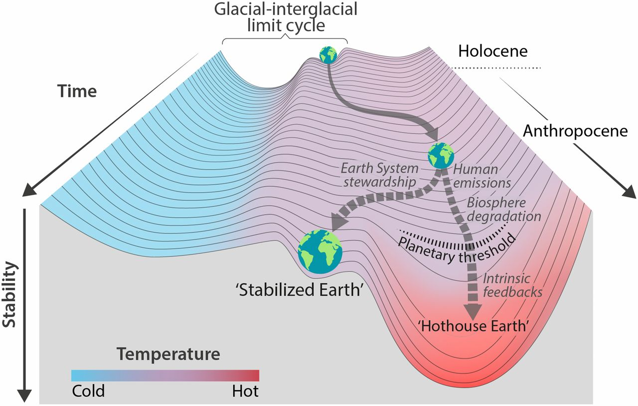
A strategy of “Earth System Stewardship” formulated in Hothouse/Icehouse terms
The warmer it gets, the more likely we slip irreversibly into “Hothouse Earth” mode.
The goal would be to bring us to a “Stabilized Earth” that looks intermediate between Icehouse and Hothouse Earth.
We’ve already investigated ice/albedo feedback (Cambio 3.0). Coming up is an investigation into the health of the terrestrial CO2 feedback itself.
*
Steffen et al, PNAS 2018: https://www.pnas.org/content/115/33/8252

